Slide 1
GIS – Whirlwind Tour
(In 25 slides)
What, Why, How

Slide 2
GIS
Geographical Information Science
  Not just computerised maps
Data Capture ('EO' – though often = just physical/RS)
  Survey: GPS, EDM, Laserscanner
  RS: Aerial/Satellite, but also other sensors, Sensor Networks
  Primary Data, Secondary Data (verification techniques/theory/PAI)
Analysis, 2D Map – Cartography, also whole field of (Geo)Visualisation, (incl. 3D)
Visualisation can also permit further analysis
  Exploratory (Spatial) Data Analysis – EDA/ESDA

Slide 3
GIS – Three or Four Kinds
Desktop Application / Full Package
Web Mapping / Feature Server / Server GIS
Web Browser with GIS Tools / Thick Client
Apps, Mashups, APIs – Distributed GIS

Slide 4
Spatial Phenomena
Land Use – Urban, Rural, Building Types
Flood Risk, Water Transport, Soil Type
Topography – Elevation, Slope, Aspect
  How does topog’ affect ‘occurrence’ in landscape
People – Travel to work, shop, emergency services

Slide 5
Modelling
Conceptual Models
  To understand world, predict conditions at locations in time and/or space
Mathematical Models
  Numerical models where formalised - some idealised, some less so
Data Models
  Structure and flow of information in time and space
Spatial Data – often (not always) represented in maps
  (Lots of) Data with spatial component, some attempts to address time too
Computerised Spatial Data -> Quick Spatial Analysis over wide extent
  GIS – Geographical Information Science (and/or Systems)

Slide 6
GIS History / Software
Geography Techniques (by hand) pre 1960s: John Snow, Minard’s Map (Napoleon)
Forestry – Canada (+E Africa) - CGIS
  First GIS – Roger Tomlinson 1960+, operational from 1971+
USA – Government Organisations: USGS, US Forest Serv, others incl. CIA
Academia
  Edinburgh – GIMMS 1970+ (Sold from 1973), MSc GIS 1985+
  Harvard – Computer Graphics and Spatial Analysis Lab 1965
ESRI 1969 Env. Consultancy – Arc/Info 1982 -> ArcView Desktop 1995 -> ArcGIS 1999
Physics/Space (Moon landings) later CAD/Utilities – LaserScan/Intergraph 1969
Demographics/Consultancy – MapInfo 1986
OpenSource – GRASS, Quantum GIS (QGIS), gvSIG, … link to DBMS
Web GIS – WMS, WFS, Google Maps, Google Earth, OGC, OpenStreetMap

Slide 7
Data Types
Vector – Discrete Entities within space
  Points
  Lines
  Polygons
Raster – Contin’s Field/Surface across space
  Elevation
  pH
  Growth Pot’l as secondary data based on above

Slide 8
Attributes
Vector – Multiple Attributes (Properties)
  Attributes are of each feature (point, line, poly)
Raster – Single Attribute (Value) e.g. pH
  Each cell has a different value of this attribute
  BUT! Can also have in turn Value Attributes e.g.
  1 = Acid, 7 = Neutral, 14 = Alkaline
  BUT! Again only one per value!

Slide 9
Model Framework to use – 1?
Q. For mapping HGVs across Europe?
  Ans: Lines – A Linear Network (Vector)
  Lorries constrained to linear road network
  Each road can have multiple attributes: speed limit, length, width, number of lanes

Slide 10
Model Framework to use – 2
Q. To model flow/drainage in moorland?
  Ans: Raster Grid – A continuous surface
  Each cell can have a flow direction
  Need multiple spatially co-incident grids to combine in order to achieve end result (answer)

Slide 11
Spatial Co-incidence – Map Layers
Combination of spatial and aspatial (often numerical) manipulation of data
Grids lie on top of each other. Co-incident cells can then be combined numerically to give result.
GIS all about combining info from different Layers
Layers form a stack – but usually only in model – multiple measures found in same x,y,z (cell) location
  E.g. elevation, pH, salinity – each of these in different grid layer

Slide 12
Overlay – Attribute Transfer
Can convert between raster + vector but limited and tend to be treated in isolation but can be viewed together easily
Can however easily combine vector layers – mathematical combination of geometry – easy to cut-up and intersect => Vector Overlay
Vector Overlay all about Attribute Transfer

Slide 13
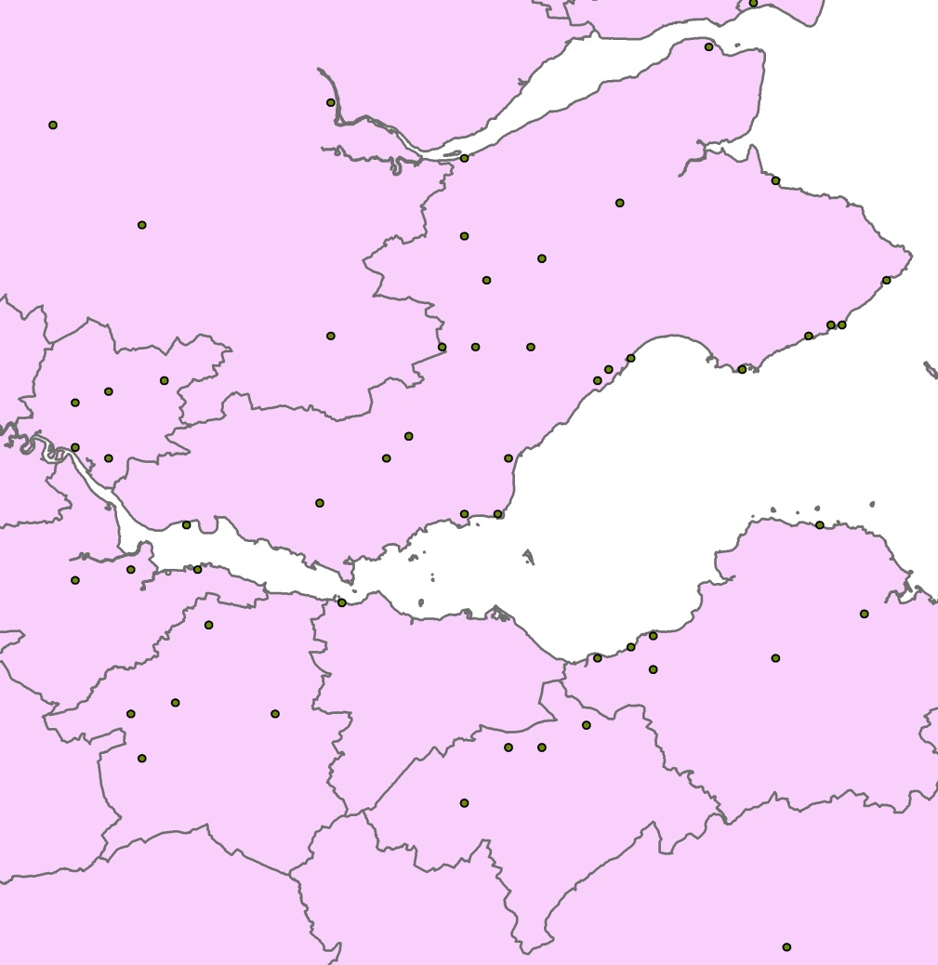
Overlay – Point in Polygon
Which district has the most towns?
  Count the number of town points in each district poly
In which district does this town lie?
  Attribute (verb) each town with the name of the district polygon in which it falls
Points 'lie on top' of solid coloured polys in our stack

Slide 14
Overlay – Polygon Overlay
Degree of overlap between different districts/zones/catchment areas
E.g. Erase SSSI polygons from potential Golf Course polygons (unless you are a Trump)
Intersect pollution zones with population zones (> 10,000 pop) to get danger zones!

Slide 15
Co-ord’te Reference Systems (CRS) –
Map Projections, Datums
Spatial Data can be measured/located in:
  Angular Units – Lat, Long, e.g. 56º23'4'' (dms), 56.38º (dd)
  Linear Units – Flat Grid-based: Easting, Northing, e.g. metres, ft
Spherical (Angular) = 'Geographic' CRS (unprojected)
Flat Planar (Linear) = 'Projected' CRS, e.g. BNG, UTM
All CRS based on a reference datum – a model of the Earth’s surface/shape. This MUST be correctly defined, for any later projection (curved to flat) to WORK correctly.
If collecting GPS data in Britain, we want to end up in BNG but MUST define source data as WGS84 datum / geographic sys as THAT is what the GPS uses. Once source data defined we can project to BNG.

Slide 16
Simple GIS – Google Earth
Last point less of an issue if using Simple GIS – Google Earth – uses WGS84 lat long; loads in KML files – now often saved by GPS software directly. E.g. GPS Utility. Or just write raw KML or use converter prog.
Simple annotation / measurement tools etc. but also clever features, e.g. timestamp allows animation/viewing change through time
Beware – Google Maps uses its own Mercator projection but you can link to KML URL in Google Maps
Can make 'mashups': Google Maps, JavaScript, WMS, Scanned Maps
NO pricey GIS package required

Slide 17
Industry Standard - ArcGIS
ArcGIS: ArcMap – 2D, ArcScene 3D, ArcCatalog, others
Relatively easy to get started, though can at times be overwhelming! Some similarity to Word/Excel in structure
ArcToolbox now primary interface to functionality (or command line) though various toolbars (drop-down menus) too
Beware – from v10 Arc tries to save everything to a default geodatabase in user’s home path. In UoE, home path is M: and for undergrads this may still be quite small. Thus must keep some space on M: even if other space available

Slide 18
File Formats
Shapefile – Actually a set of 3-6 files (min 3)
  Prob one of most widely used file type – though closed, proprietary format
  Myfile.shp (geom), Myfile.shx, Myfile.dbf (attrs), .prj, ...
  Move each file, or .zip all together at OS; just move the .shp in ArcCatalog
Geodatabase
  Single file at OS level – neatly holds all vectors & rasters
  File Geodatabase now 1Tb (and there are ways to get up to 256 Tb!)
  In time will likely be the only thing to use (other GIS still use shp for now)
Coverage (vector); Grid (raster)
  Older formats you may need to know about
  Hybrid structure of one folder mygrid and a shared info folder – shared between ALL coverages and grids in a containing folder
  Move ALL of these at OS – or better still use ArcCatalog only!

Slide 19
Data Storage Theory
Hybrid Arc/Info model based on storing correct type of data in best place for that
Data can be re-joined when required
Same principle means store only relevant info in a table of particular feature types and join these at query/display time – also use key tables & numbers to reduce data vols
Relational DBs good for this and can store spatial data – Many offer spatial extensions with spatial analysis functions

Slide 20
Database Storage
Can connect GIS to RDBMS for:
  Better querying
  Robust storage
  Multi-user access and sophisticated control (only one user edits electoral district at a time!)
Examples:
  ArcSDE – Create GeoDatabase in RDBMS
  SPIT – Connects QGIS to PostgreSQL(PostGIS)

Slide 21
Open (Source) GIS
PostGIS, MySQL – Open Source DBMS – implement OGC standards
OGC – Consortium of 482 Companies/Orgs – Define Open Standards
OSGeo Found’n – Support develop’t of op’n source Geospatial software
GRASS – Orig. US Army, now project of OS Geo
GDAL (Conversion), GEOS (Geometry), rasdaman (rasters)
Quantum GIS (QGIS) – Another OSGeo Project
  MapServer export, OpenStreetMap editor, Run GRASS datasets/tools within
MapTiler (uses GDAL2Tiles) – Create OpenLayers/Google Maps Tilesets

Slide 22
Web GIS
Tools – MapTiler, OpenLayers, MapServer, GeoServer
Developers’ Platforms – JavaScript, AJAX, SVG, Java
Google Earth/Maps, Virtual Earth, Streetmap
OpenStreetMap, (interesting to compare against OS!)
OS Get-a-map; OS OpenData (Apr 2010); OpenData API
Simple User Requirements? – ArcGIS Online

Slide 23
The Future 1 – PDAs, AR, Apps
Move from mainframe to desktop to distributed desktops, and distributed servers
PDAs and Phones – ArcPad, GPS Maps
Augmented Reality – Scan horizon, Utilities
AIS – Ships, Planes – Track in Google Earth

Slide 24
The Future 2 – LBS, Sensors, Clouds
Location Based Services, Sensor Networks
Cloud Computing, Ubiquitous Computing
Tracking People? Civil Liberties / Freedoms?
Social inequality – advantaged vs disadvantaged?
Free/VGI => more folk making bad maps - noise?
But a more skilled-up knowledgeable population…?

Slide 25
Thank You!
Questions?

